Slide 1
Instruction for using Syrmdesign for surface-mounted permanent magnet motor
Dec 14 2015
chao.lu@polito.it

Slide 2
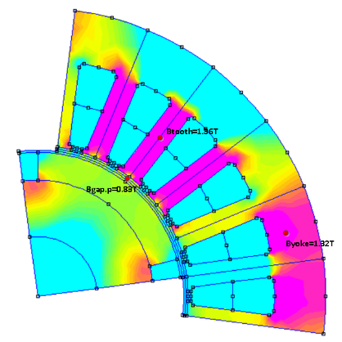
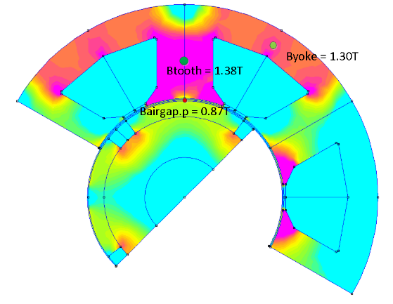
Introduction
Two types of SPM motors are concerned in Syr-e, depends on the winding type:
1.Distributed windingS (DW)
2.Concentrated windingS (cw)
Magnetic circuit
Torque and power factor
Magnetic circuit
Torque and power factor
**The parameters used for SPM motor are the same as those of SyR motor, they are defined in ‘2015 11 08 - syrmDesign instructions’

Slide 3
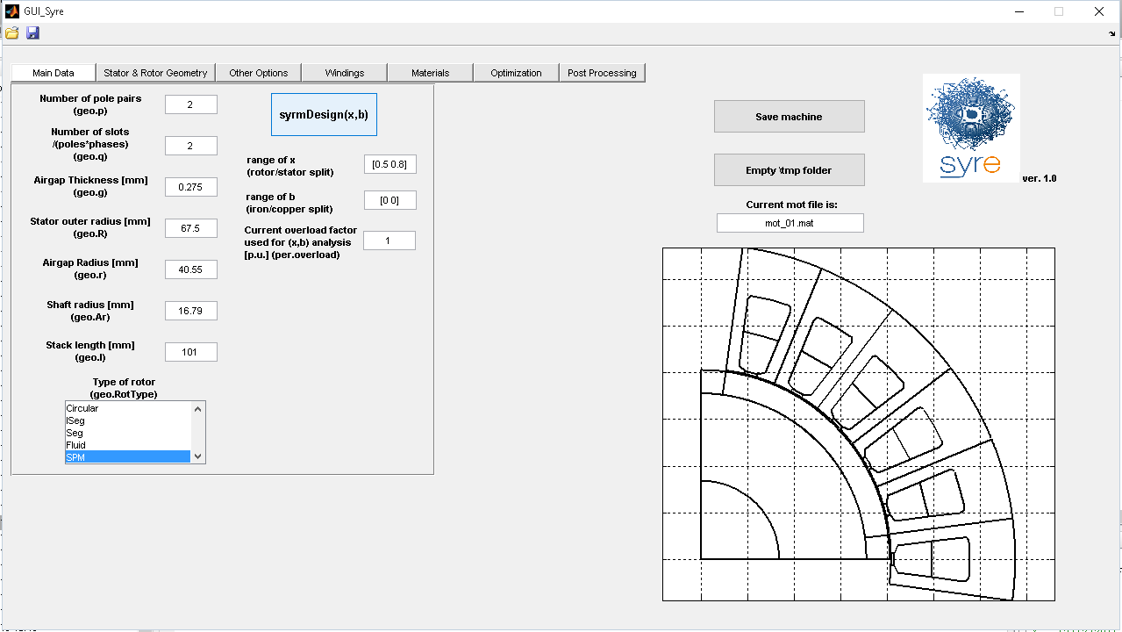
Parametric Design
The syrmDesign button runs parametric analysis in the (x-b) plane [..] and outputs torque and power factor as a function of x and b, to guide the initial stages of the design
T=26.1Nm,PF=0.91
[..] is a paper we still have to write

Slide 4
DW
Distributed Winding (DW) Machines

Slide 5
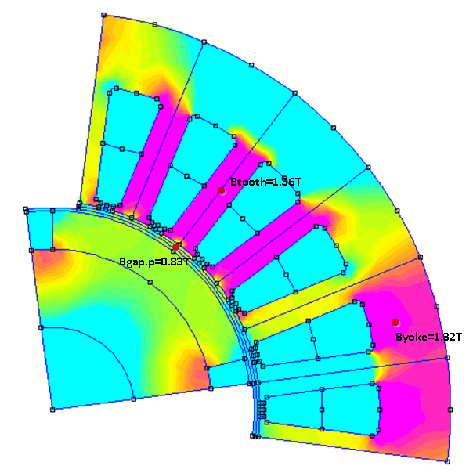
DW: Magnetic Circuit Design
1. Magnetic circuit
Example: 4-pole,24slots full pitch motor
Assuming Bfe = 1.35T(flux density in both yoke and tooth); b = 0.6; Br = 1.026T;
So the peak airgap flux density should be Bgap.p = Bfe*b=0.81T.
The gap between analytical and FEA result is less than 10%
Available: syre\demo\SPMtestDW01.fem
FEA result

Slide 6
DW: Torque and PF
2. Torque and power factor
For the same motor, outer radius is 67.5mm, x=0.5, rated current is 29.5A. Select x=0.5,b=0.6 in the tradeoff map of torque and PF.
FEA result
T=26.1Nm,PF=0.91
Due to the small gap between estimated and FEA flux density in airgap, the torque has 20% difference, but the PF is quite matched
Available: syre\demo\SPMtestDW01.fem we can create a demo folder and add significant cases for internal and external use

Slide 7
DW: Demo 2
Please, add here another demo take from the same b – x plane
(1 slide is enough both for mag. Circ and T – PF)

Slide 8
DW: Demo 3
Please, add here another demo, with different size, q, p and data

Slide 9
CW
Concentrated winding machines

Slide 10

Concentrated winding (CW)
1. Magnetic circuit
Take an example:
4-pole,6slots fractional slot, q=2
Assuming Bfe = 1.35T(flux density in both yoke and tooth); b = 0.62; Br = 1.026T;
So the peak airgap flux density should be Bgap.p = Bfe*b=0.837T.
The gap between analytical and FEA result is less than 10%
FEA result
** to check the magnetic circuit, please get you rotor in the right position

Slide 11
Concentrated winding (CW)
2. Torque and power factor
For the same motor, outer radius is 108mm, x=0.5, rated current is 178A. Select x=0.5,b=0.62 in the tradeoff map of torque and PF.
FEA result
T=150 Nm, PF =0.84
Both torque and power factor have a margin less than 5%

Slide 12
Demo 2 and demo 3
Same thing:
Demo 2 is from same b – x plane
Demo 3 is with q = 2/5

Slide 13
Notice
1. for SPM motor, please select magnet material and define Br before using syrmdesign.
2. the range of b is narrow, the lower limit is constrained by demagnetization and the upper limit is confined by the efficiency of lm/g ratio. After Br is defined, there is a suggested range of b that is calculated, according to 4.5<lm/g<6.5.

